Slide 1

Smart Fertilizer Spraying System Using Plant Disease Severity Analysis
Smart Fertilizer Spraying System Using Plant Disease Severity Analysis
by
Y Trinesh Reddy
Roll No. 234G5A3311
G Sreeja
Roll No. 224G1A33A9
B Revathi
Roll No. 224G1A3380
Y Sravani
Roll No. 224G1A33A4
Under the guidance of
Dr. C. Sasikala M.Tech., Ph.D.
Associate Professor
Department of Computer Science and Engineering (AI & ML)
Srinivasa Ramanujan Institute of Technology
(Affiliated to JNTUA & Approved by AICTE) (Accredited by NAAC with ‘A’ Grade & Accredited by NBA (EEE, ECE & CSE)
Rotarypuram Village, B K Samudram Mandal, Ananthapuramu – 515701.
2025 - 2026
B-10
Srinivasa Ramanujan Institute of Technology 1

Slide 2
Contents
Abstract
Introduction
Objectives of Project
Literature survey for objectives
Existing System
Proposed System
Planning
Requirements
Data Flow Diagrams
Design
Implementation & Methodology
Data Preprocessing Techniques
Code
Screenshots (Project Output)
Future Scope
Applications & Conclusion
References
GitHub Link
B-10
Srinivasa Ramanujan Institute of Technology
2

Slide 3
Abstract
The Smart Fertilizer Spraying System with Plant Disease Severity Analysis is an automated agricultural robot designed to enhance crop management through precision farming. The system employs a Raspberry Pi equipped with a USB camera to capture plant images and analyze disease severity using advanced image processing techniques. Based on the detected severity levels, the system dynamically regulates fertilizer spraying duration through three dedicated nozzles, ensuring precise application and minimizing wastage.
An Arduino microcontroller manages the operation of DC motors, water pumps, relays, and the robot chassis for efficient movement. Powered by a 12V battery and supported by a 9V solar panel, the system offers sustainable and energy-efficient operation. Bluetooth connectivity facilitates wireless monitoring and control. By combining disease severity detection with intelligent fertilizer management, this system reduces human intervention, optimizes resource utilization, and promotes eco-friendly farming practices
B - 10
Srinivasa Ramanujan Institute of Technology
3

Slide 4
Introduction
The Smart Fertilizer Spraying System with Plant Disease Severity Analysis is an automated agricultural robot developed to improve crop management through precision farming. The system uses a Raspberry Pi integrated with a USB camera to capture plant images and analyze disease severity using advanced image processing techniques. Based on the detected severity levels, the system automatically controls the fertilizer spraying process by adjusting the spray duration through three dedicated nozzles, ensuring accurate application while minimizing fertilizer wastage.
An Arduino microcontroller manages the robot’s movement and controls hardware components such as DC motors, water pumps, relays, and the chassis to enable efficient field navigation. The system is powered by a 12V battery supported by a 9V solar panel, providing sustainable and energy-efficient operation. Bluetooth connectivity allows wireless monitoring and control of the system. By integrating plant disease severity detection with intelligent fertilizer management, the proposed system reduces human intervention, optimizes resource utilization, and promotes eco-friendly and sustainable agricultural practices.
Srinivasa Ramanujan Institute of Technology

Slide 5
Problem statement
Plant diseases significantly reduce crop yield and quality, directly affecting farmers income and overall agricultural productivity. Traditional disease monitoring and fertilizer spraying methods are manual, time-consuming, and labor-intensive. Farmers often apply fertilizers or pesticides uniformly across the field without assessing the actual severity of infection. This results in chemical wastage, increased operational costs, and environmental pollution. Continuous monitoring of large agricultural fields is also difficult and inefficient.
Therefore, there is a need for an intelligent and automated system that can detect plant diseases in real time, analyze their severity accurately, and spray fertilizer precisely where required. The proposed Smart Fertilizer Spraying Robot aims to support precision agriculture, reduce human effort, minimize chemical usage, and promote sustainable and efficient farming practices.
Srinivasa Ramanujan Institute of Technology
6

Slide 6
Objectives Of Project
To implement plant disease severity analysis using image processing techniques.
To capture real-time crop images using a Raspberry Pi with USB camera.
To classify disease severity levels accurately for effective treatment.
To automatically control fertilizer spraying duration based on detected severity.
To ensure precise fertilizer application using multiple dedicated nozzles.
To reduce fertilizer wastage and prevent environmental damage.
To integrate Arduino-based control for robot movement and hardware operations.
To provide wireless monitoring and control using Bluetooth technology.
To promote eco-friendly, energy-efficient, and sustainable farming practices.
To minimize human intervention in fertilizer spraying operations.
Srinivasa Ramanujan Institute of Technology

Slide 7
Literature Survey
Plant Disease Detection System for Smart Agriculture:
The Indian economy relies on agriculture to a great extent. In traditional agricultural practices, farmers identify crop diseases either through direct visual inspection or by consulting experts, sometimes by sharing diseased crop images through online services. However, continuous monitoring and assessment of disease severity cannot be performed manually, often leading to delayed treatment and increased crop loss.
In the plant disease detection system, the image to be tested is acquired, pre-processed, segmented, and analyzed to determine both the type of disease and its severity level. The classification and severity estimation are performed using a probabilistic linear classifier, namely the Naive Bayes algorithm. The system is developed using Android Studio, and python is used as the programming language.
The application identifies plant diseases based on pixel intensity analysis and evaluates the extent of disease spread (severity) on the affected leaves. Based on the detected severity level, the system predicts plant growth conditions and provides recommendations for appropriate fertilizers and pesticides. The developed system achieves an accuracy and its implementation reduces manpower requirements while improving productivity through timely and severity-based intervention.
.
Srinivasa Ramanujan Institute of Technology
6

Slide 8
Literature Survey
2. Crop Care – An AI-Integrated System for Smart Crop Protection and Disease Detection:
Agriculture plays a vital role in sustaining human life by ensuring food security for a growing population. However, plant diseases and improper fertilizer application often lead to reduced crop yield, economic losses, and environmental damage. To overcome these challenges, Crop Care proposes an AI-integrated automated agricultural robot designed to detect plant disease severity and perform precision fertilizer spraying without direct human intervention.
The system utilizes a Raspberry Pi integrated with a USB camera to capture real-time images of crops and analyze disease severity using advanced image processing and machine learning techniques. Based on the identified severity level, the system automatically regulates fertilizer spraying duration through three dedicated nozzles, ensuring accurate application while minimizing fertilizer wastage.
An Arduino microcontroller is employed to control the robot’s movement and manage hardware components such as DC motors, water pumps, relays, and the chassis, enabling efficient navigation across the field. The system is powered by a 12V battery supported by a 9V solar panel, ensuring energy-efficient and sustainable operation. Additionally, Bluetooth connectivity enables wireless monitoring and control of the robot.
By combining plant disease severity detection with intelligent and automated fertilizer management, the proposed system significantly reduces human effort, optimizes resource utilization, prevents overuse of fertilizers, and supports eco-friendly and sustainable farming practices.
Srinivasa Ramanujan Institute of Technology

Slide 9
Existing System
Traditionally, crop health monitoring and fertilizer application rely on manual inspection, where farmers visually examine plants to identify diseases, pests, or nutrient deficiencies and then apply fertilizer or pesticides using hand-operated or tractor-mounted sprayers.
This approach is labor-intensive, time-consuming, and prone to human error, often resulting in under- or over-application of chemicals. Additionally, uniform spraying without considering disease severity leads to wastage of resources and potential environmental harm. Compared to this traditional method, automated systems that integrate disease severity detection with targeted fertilizer application offer greater efficiency, accuracy, and sustainability.
Srinivasa Ramanujan Institute of Technology

Slide 10
Proposed System
The proposed Smart Fertilizer Spraying System integrates plant disease severity detection with precision fertilizer application to optimize crop management. The system uses a Raspberry Pi equipped with a USB camera to capture real-time images of plants. Image processing techniques are applied to analyze these images and determine the severity of detected diseases. Based on the severity level, the system intelligently adjusts the spraying duration of three separate nozzles, ensuring precise fertilizer application and minimizing waste.
An Arduino microcontroller controls the movement of the robot chassis, DC motors, water pumps, and relays to execute spraying operations efficiently. The system is powered by a 12V battery and supported by a 9V solar panel for sustainable operation. Bluetooth communication enables wireless monitoring and control, allowing farmers to track system performance and adjust settings remotely. This approach reduces human intervention, improves crop health, and promotes eco-friendly farming practices.
Srinivasa Ramanujan Institute of Technology

Slide 11
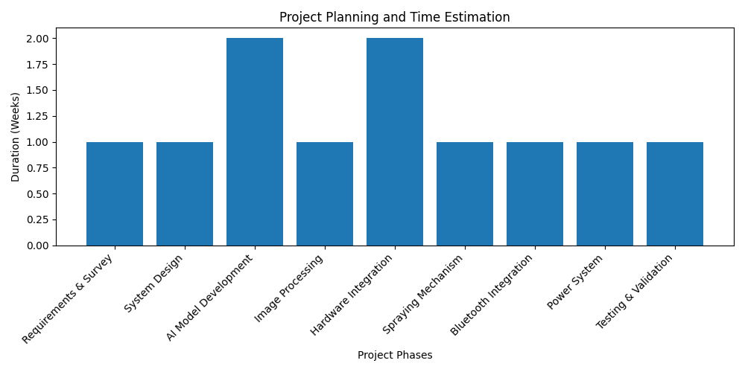
Planning
B-10
Srinivasa Ramanujan Institute of Technology

Slide 12
Planning
Objectives
The objective of this project is to develop a Smart Fertilizer Spraying System using deep learning and embedded systems to improve precision agriculture. The system uses YOLOv8 to detect tomato disease severity and automatically control fertilizer spraying.
Scope
In this proposed model, tomato diseases are detected from images using the YOLOv8 model. Based on the severity level, the system automatically sprays fertilizer using Raspberry Pi and Arduino to improve crop management and reduce chemical wastage.
Performance
The system aims to achieve accurate disease severity detection and efficient fertilizer spraying. It helps reduce manual effort, optimize fertilizer usage, and support sustainable farming practices.
Srinivasa Ramanujan Institute of Technology
6

Slide 13
Requirements
Software Requirements
Operating System: Raspberry Pi OS, Windows 10/11
Languages: Python, Embedded C
IDE / Tools: Arduino IDE, Thonny / VS Code
Libraries: OpenCV, NumPy
Communication: Bluetooth (Serial)
Hardware Requirements
Controllers: Raspberry Pi, Arduino
Camera & Memory: USB Web Camera, Micro SD Card
Power Supply: 12V Battery, 9V Solar Panel, 12V Adapter (2A)
Motors & Actuators: DC Motors (2), DC Water Pumps (3)
Control Modules: Motor Driver, Relays (3), Bluetooth Module
Mechanical Setup: Robot Chassis, Wheels (4), Dummy Shafts (2)
Spraying System: Nozzles (3), Plastic Boxes
Others: LEDs, Slide Switch
B-10
Srinivasa Ramanujan Institute of Technology

Slide 14
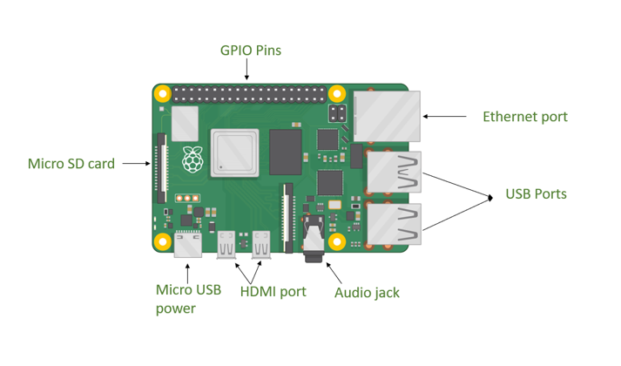
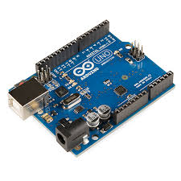
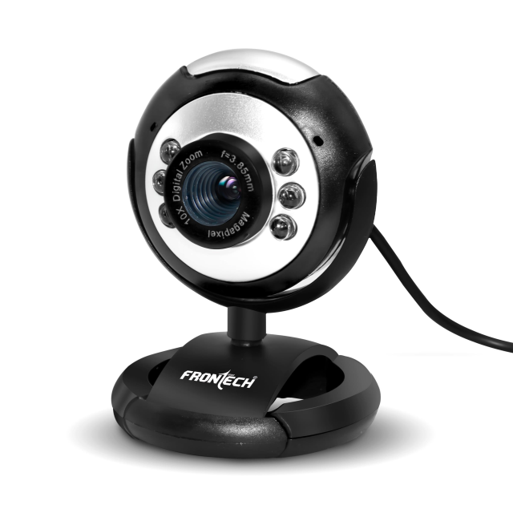
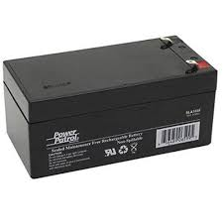
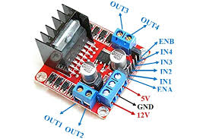
Components
Raspberry Pi
Web cam
Arduino Uno
Raspberry Pi:
12v Battery
Motor Driver
Srinivasa Ramanujan Institute of Technology

Slide 15
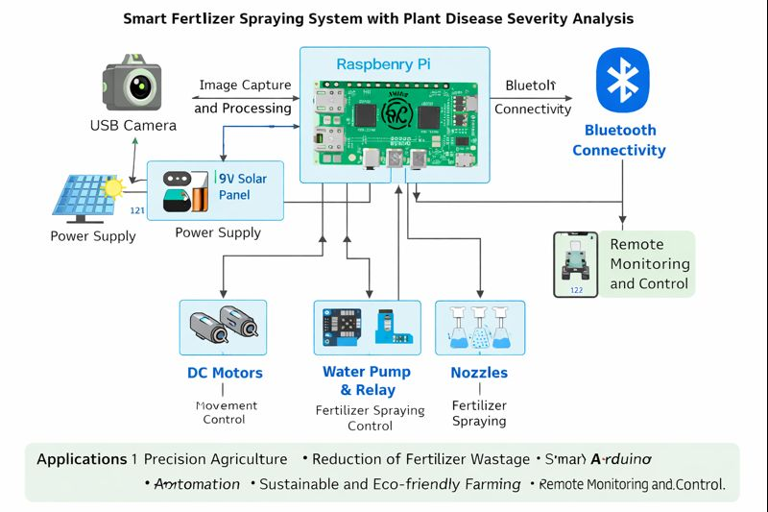
Data Flow Diagram
Srinivasa Ramanujan Institute of Technology

Slide 16
Design
The proposed Smart Fertilizer Spraying System is designed to integrate deep learning, embedded systems, and automated hardware to improve precision agriculture. The system consists of a camera module, Raspberry Pi, Arduino microcontroller, motor driver, pump mechanism, and power supply.
First, the camera captures images of tomato plants, which are processed by the Raspberry Pi using the YOLOv8 deep learning model to detect disease severity levels. Based on the detected severity (low, medium, or high), the Raspberry Pi sends a control signal to the Arduino microcontroller.
The Arduino then controls the motor and pump system to spray fertilizer for a specific duration depending on the severity level. This automated process ensures that fertilizer is applied only where needed, reducing chemical wastage and improving crop health.
The overall system design enables real-time monitoring, automated fertilizer spraying, and efficient crop management, making it suitable for modern precision agriculture applications.
.
Srinivasa Ramanujan Institute of Technology

Slide 17
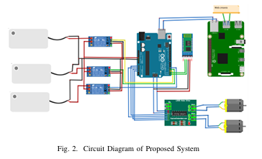
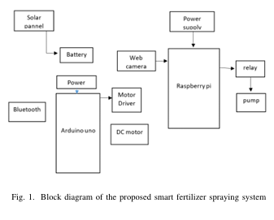
Block Diagram
Srinivasa Ramanujan Institute of Technology

Slide 18
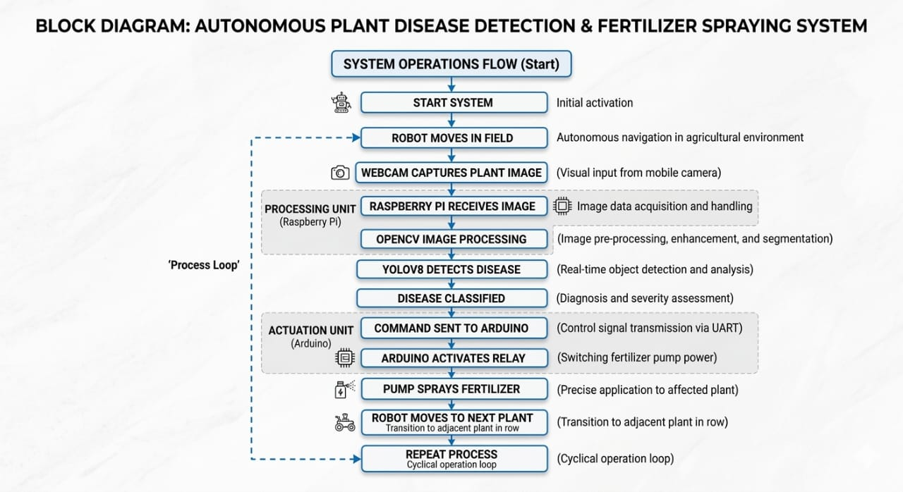
Block Diagram
Srinivasa Ramanujan Institute of Technology

Slide 19
Methodology
The Smart Fertilizer Spraying Robot begins its operation by initializing all hardware components including the Raspberry Pi, Arduino, USB camera, DC motors, water pump, relay module, Bluetooth module, and rechargeable battery. Proper communication is established between the Raspberry Pi and Arduino for coordinated functioning. As the robot moves along the crop rows, the camera captures real-time images of the plants. These images are processed by the Raspberry Pi using preprocessing techniques such as resizing, noise removal, and color conversion to enhance image quality.
Image segmentation and thresholding methods are then applied to detect infected regions and calculate the percentage of affected area. Based on the severity level (Low, Medium, or High), control signals are sent to the Arduino to regulate the pump and adjust the spraying duration accordingly. If no disease is detected, the robot continues its movement without spraying. This integrated process ensures accurate disease detection, precise fertilizer application, and efficient coverage of the agricultural field.
Srinivasa Ramanujan Institute of Technology

Slide 20
Implementation details
The Smart Fertilizer Spraying Robot is implemented using an integrated Raspberry Pi and Arduino architecture. Plant disease detection is performed using YOLOv8, which enables fast and real-time object detection instead of using a traditional CNN model. A custom dataset of plant images is collected and trained, achieving approximately 80% detection accuracy.
The Raspberry Pi processes images captured from the camera and determines the disease severity level. Based on the severity classification, control signals are sent to the Arduino for spraying action. The fertilizer spraying system is controlled using a relay module that activates the water pump. The spraying duration is set according to severity levels: High severity – 7 seconds, Medium severity – 5 seconds, and Low severity – 2 seconds.
Bluetooth communication is used to interact with the Arduino for wireless control and monitoring. For interfacing and accessing the Raspberry Pi remotely, VNC Viewer is used to execute and monitor the YOLOv8 detection model. This implementation ensures precise spraying, real-time detection, and efficient coordination between hardware and software components.
Srinivasa Ramanujan Institute of Technology

Slide 21
Data Preprocessing Techniques
Image Resizing Captured leaf images are resized to a fixed resolution to reduce processing time and ensure uniform input.
Noise Removal Filters such as Gaussian or Median filters are applied to remove noise caused by dust, lighting, or camera disturbances.
Image Enhancement Contrast enhancement techniques are used to highlight disease-affected regions on the leaf surface.
Color Space Conversion RGB images are converted to HSV or LAB color space for better separation of disease colors from background and lighting effects.
Image Segmentation The leaf region is separated from the background using thresholding or color-based segmentation to focus analysis on infected areas.
Image Normalization Pixel intensity values are normalized to a standard range to improve consistency and accuracy during disease analysis.
Feature Extraction Important features such as color, texture, and shape are extracted from the processed image to identify disease severity levels.
Srinivasa Ramanujan Institute of Technology

Slide 22
Code
#include <SoftwareSerial.h>
int m1 = A0, m2 = A1, m3 = A2, m4 = A3;
int relay1 = 2, relay2 = 3, relay3 = 4;
SoftwareSerial mySerial(5, 6);
void setup() {
Serial.begin(9600);
mySerial.begin(9600);
pinMode(m1, OUTPUT);
pinMode(m2, OUTPUT);
pinMode(m3, OUTPUT);
pinMode(m4, OUTPUT);
pinMode(relay1, OUTPUT);
pinMode(relay2, OUTPUT);
pinMode(relay3, OUTPUT);
}
System Initialization
Srinivasa Ramanujan Institute of Technology

Slide 23
Code
void forward() {
digitalWrite(m1, HIGH);
digitalWrite(m2, LOW);
digitalWrite(m3, LOW);
digitalWrite(m4, HIGH);
}
void backward() {
digitalWrite(m1, LOW);
digitalWrite(m2, HIGH);
digitalWrite(m3, HIGH);
digitalWrite(m4, LOW);
}
void Stop() {
digitalWrite(m1, LOW);
digitalWrite(m2, LOW);
digitalWrite(m3, LOW);
digitalWrite(m4, LOW);
}
Motor Control System
Srinivasa Ramanujan Institute of Technology

Slide 24
Code
void pump1() { // High severity
digitalWrite(relay1, HIGH);
delay(6000);
digitalWrite(relay1, LOW);
}
void pump2() { // Low severity
digitalWrite(relay2, HIGH);
delay(2000);
digitalWrite(relay2, LOW);
}
void pump3() { // Medium severity
digitalWrite(relay3, HIGH);
delay(4000);
digitalWrite(relay3, LOW);
}
Fertilizer Pump Control
Srinivasa Ramanujan Institute of Technology

Slide 25
Code
Disease Detection using YOLOv8
from ultralytics import YOLO
import cv2
import serial
import time
model = YOLO("/home/pi/Desktop/tamota disease/student dataset/runs/detect/train/weights/best.pt")
# YOLO Detection
results=model(frame, conf=0.30)
annotated_frame=results[0].plot()
# Get first detected disease
iflen(results[0].boxes) >0:
box=results[0].boxes[0]
cls=int(box.cls)
detected_label=model.names[cls]
cv2.imshow("Tomato Disease Detection", annotated_frame)
ifcv2.waitKey(1) &0xFF==ord('q'):
break
cap.release()
cv2.destroyAllWindows()
print("Camera OFF")
Srinivasa Ramanujan Institute of Technology

Slide 26
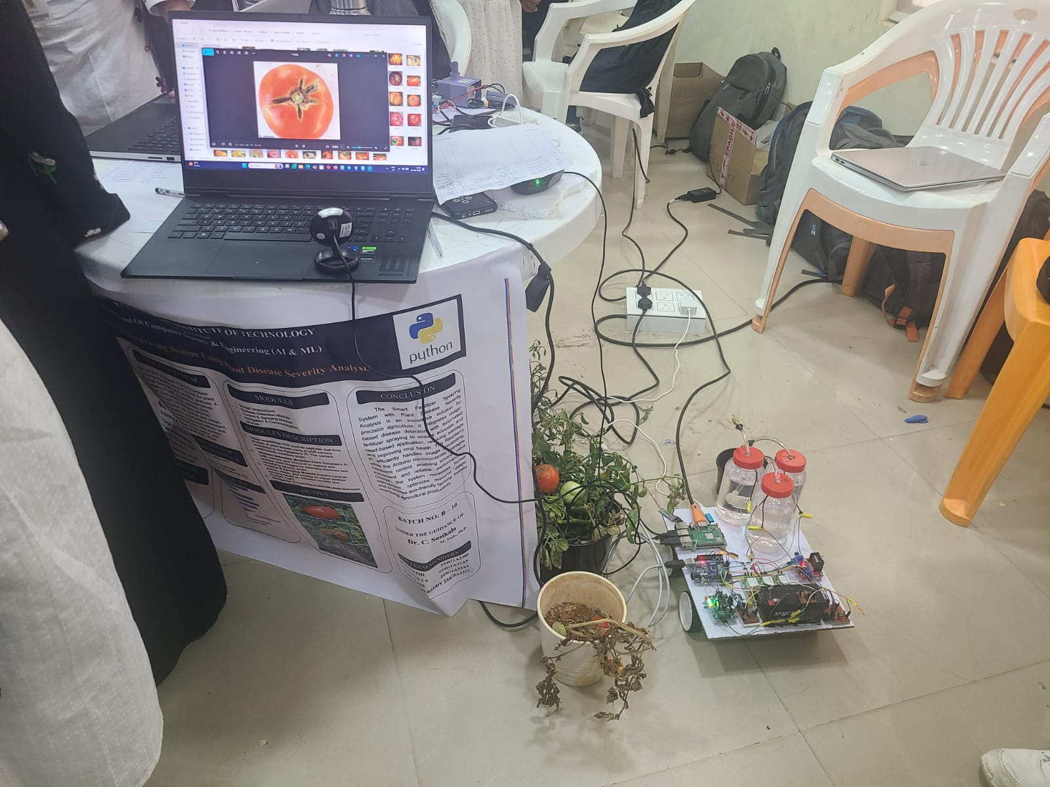
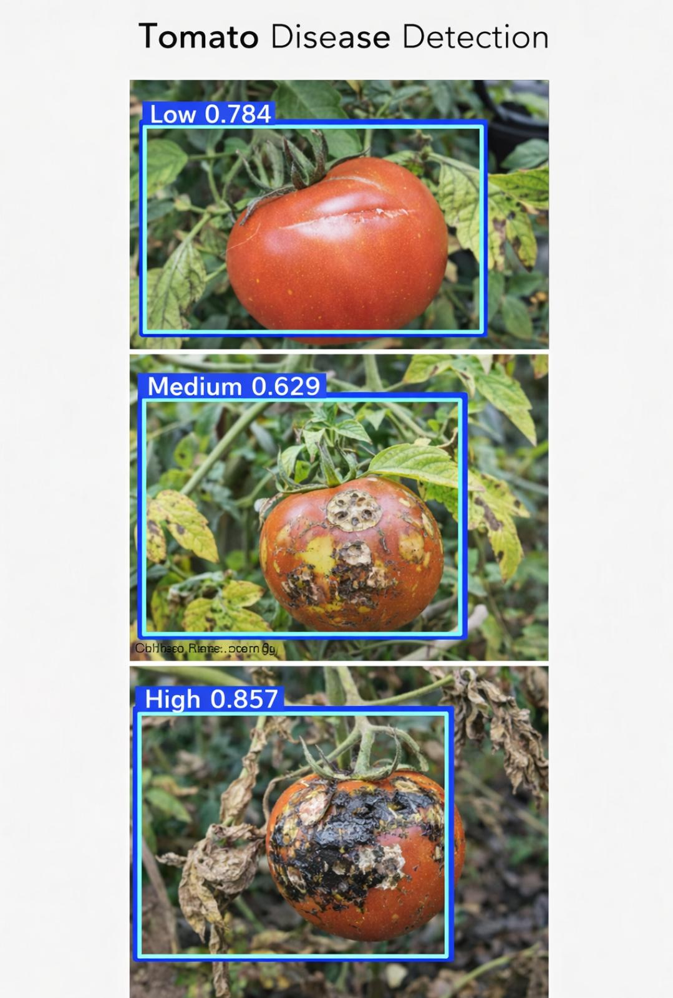
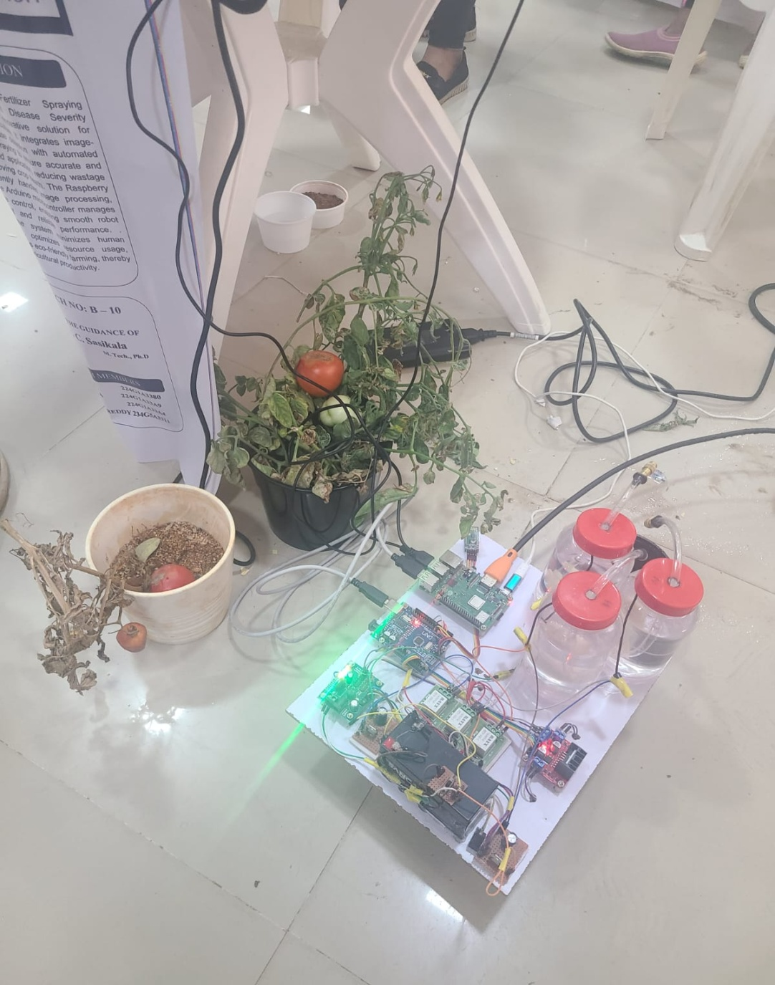
Results
B-10
B-10
Srinivasa Ramanujan Institute of Technology

Slide 27
Applications
Precision Agriculture – Automatically applies the right amount of fertilizer based on plant disease severity, improving crop health and yield.
Reduction of Fertilizer Wastage – Prevents overuse of fertilizers by spraying only where and when needed, saving cost and resources.
Smart Farming Automation – Reduces manual labor by automating disease detection, fertilizer spraying, and robot movement in agricultural fields.
Sustainable and Eco-friendly Farming – Uses solar power and optimized fertilizer usage to promote environmentally friendly agricultural practices.
Remote Monitoring and Control – Allows farmers to wirelessly monitor and control the fertilizer spraying system via Bluetooth for easy operation and decision-making.
B-10
B-10
Srinivasa Ramanujan Institute of Technology

Slide 28
Future Scope
The proposed Smart Fertilizer Spraying System can be further improved by increasing the dataset size to enhance the accuracy of disease detection. Advanced data augmentation and GPU-based training can also be used to improve the performance of the YOLOv8 model.
In the future, the system can be expanded to support multiple crop disease detection, making it useful for different types of agricultural plants. Integration with IoT-based cloud systems can enable remote monitoring and data analysis for farmers.
Additionally, features such as GPS-based navigation, autonomous field movement, and soil condition monitoring can be added to make the system more efficient. These improvements can transform the system into a complete smart farming solution for sustainable agriculture.
Srinivasa Ramanujan Institute of Technology

Slide 29
Conclusion
The Smart Fertilizer Spraying System with Plant Disease Severity Analysis presents
an effective and innovative solution for modern precision agriculture. By
integrating image-based plant disease severity detection with automated fertilizer
spraying, the system ensures accurate and need-based application of fertilizers,
thereby reducing wastage and improving crop health. The coordinated operation of
the Raspberry Pi for image processing and the Arduino microcontroller for
hardware control enables efficient robot movement and reliable system
performance.
The use of solar-assisted power enhances sustainability, while
Bluetooth connectivity provides convenient wireless monitoring and control.
Overall, this system minimizes human intervention, optimizes resource utilization,
and supports eco-friendly farming practices, making it a promising approach for
improving agricultural productivity and sustainability in real-world farming
environments.
Srinivasa Ramanujan Institute of Technology

Slide 30
Reference
Prakash M. Manikar, Shreekant Ghorpade, Mayur Adawadkar, "Plant Leaf Disease Detection and Classification Using Image Processing Techniques," International Engineering Journal, Volume 2, Issue 4, 2015.
2 Prof. Bhavana Patil, Mr. Hemant Panchal, Mr. SHUBHAM Yadav, Mr. Arvind Singh, Mr. Dinesh Patil, "Plant Monitoring Using Image Processing, Raspberry PI and IOT," Journal of Engineering and Technology, Volume 4, Issue 10, 2017
3 Navin V. Dumare, Prof. S. S. Mungona, "Identification of Cotton Leaf Diseases Using Raspberry PI," Volume 5, Issue 5, 2017, International Journal on Recent and Technology Trends in Computing and Communication.
Prathamesh. K. Kharde, Hemangi. H. Kulkarni, "A Special Method for the Detection of Grape Leaf Diseases," International Journal of Scientific Research, Volume 2, Issue 4, 2016.
Jayaprakash Sethupathy, Veni S, International Journal of Engineering and Technology, Volume 8, No 5, 2016, "Open CV Based Disease Detection of Mango Leaves."
Srinivasa Ramanujan Institute of Technology

Slide 31
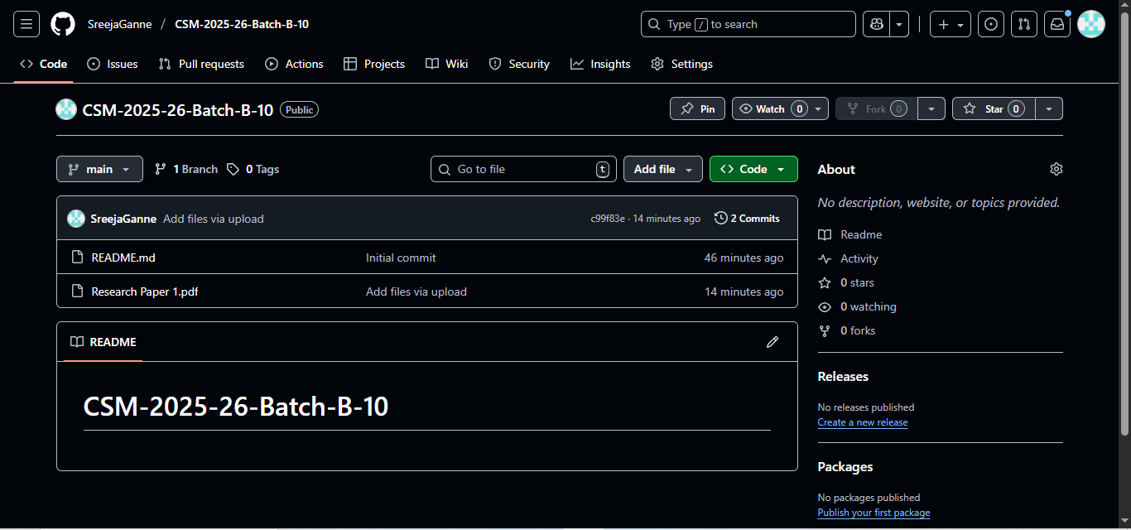
Git Hub Dashboard
Srinivasa Ramanujan Institute of Technology

Slide 32
Any Queries?
Srinivasa Ramanujan Institute of Technology

Slide 33
Thank You!!!
Srinivasa Ramanujan Institute of Technology

